Slide 1
Dussehra
Vijayadashmi

Slide 2
Dussehra
The word Dussehra comes from the word 'Dus' meaning 'Ten' and 'Hara', meaning 'annihilated'. So Dussehra is the day in which the 10 facets of Evil were destroyed.
Depicts “Victory of Good Over Evil”
This festival is celebrated for 10 days
The first nine days are called Navratri and the tenth day is called Dussehra or Vijaydashmi.
Nine days are spent for the worship of Goddess Lakshmi, Saraswati and Durga (Shakti)

Slide 3
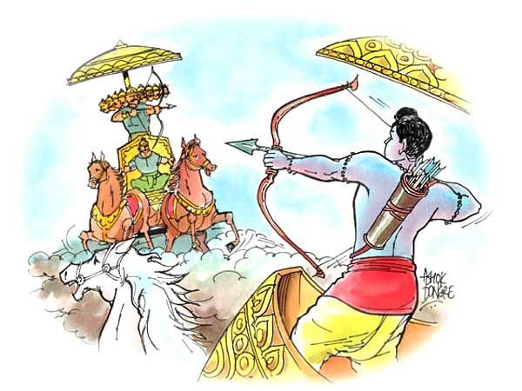
Why we Celebrate Dussehra
Ram defeats Ravan

Slide 4
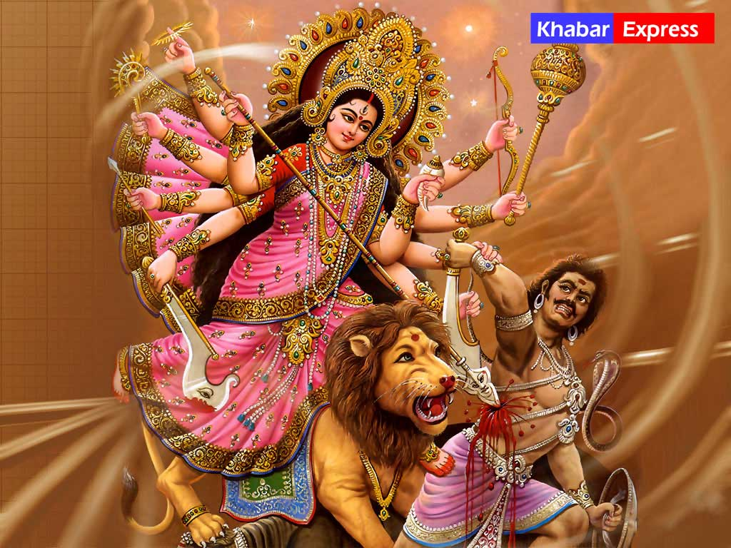
Defeat Of Mahishasura By Goddess Durga
.

Slide 5
Shami Tree
Another legend connected to the origin of Dusshera finds place in the greatest Hindu epic - Mahabharata.
According to a story, Pandavas where banished by Kauravas for 12 years and 1 year of disguise, because the former were defeated in gambling (chausar) by the latter.
Subsequently, Pandavas decided to spend their first 12 years of exile in the woods and the last year in disguise. Since they were asked to remain incognito during that period, Pandavas did not want to be exposed to others. Therefore, they lay aside their divine and powerful weapons during the exile.
They concealed their weapons under the shami tree, situated close to the place of their residence. At the end of every year of the exile, Pandavas came to the shami tree to check whether their weapons were there.
Whenever Pandavas approached the tree, they worshipped it and Goddess Durga, the presiding deity. Subsequently, the Pandavas went to the shami tree, fetched their concealed weapons and went straight to the battle field to fight the Kauravas. Pandavas emerged victorious. The event took place in Dasami and since good had achieved victory over the evil, it came to be known as Vijayadashmi. Since then, people hug each other under the shami tree and exchange its leaves.

Slide 6
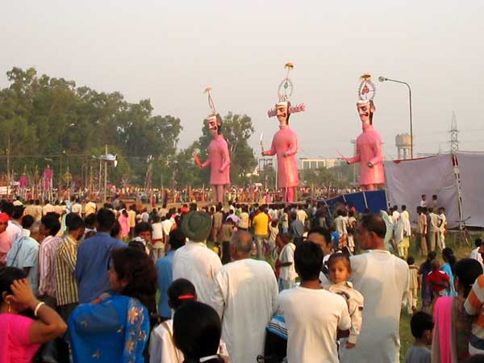
How Do We Celebrate Dussehra
Dussehra is celebrated differently in different parts of India.
1. Ramlila (North India )

Slide 7
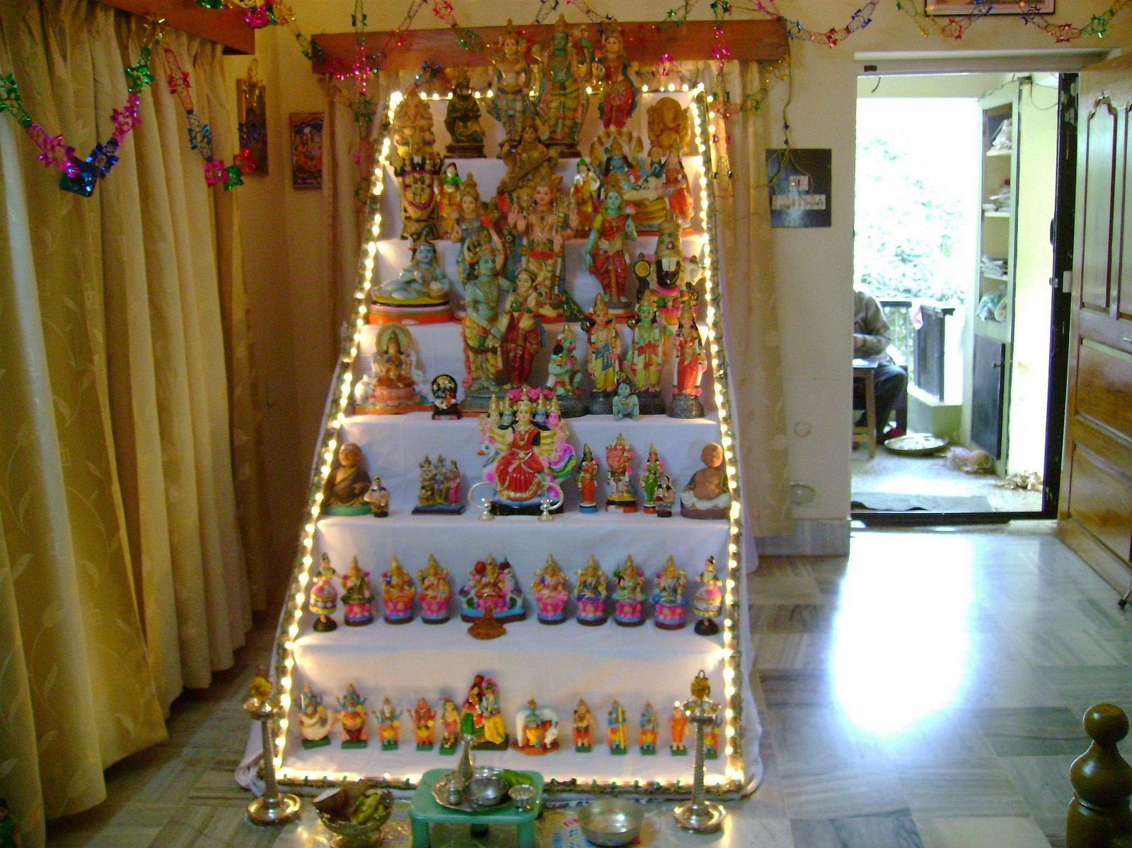
Bommai Kolu (In South India)

Slide 8
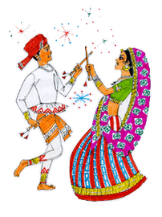
Worship Goddess Durga (In Eastern India (West Bengal))
Raas and Garba dances by men and women (Western India (Gujarat))

